Slide 1
SN Telecoms
Executive Summary Report for Predictive Call Volume Analysis
By Mariam Ariya
16th August 2022

Slide 2
Business Understanding
One of the main goals of a business is to acquire and retain its customers to grow the company. Every time a customer leaves, there's a significant loss in the time and resources invested.
The ability to predict which customer is likely to churn is therefore important as it informs the decision of the right marketing approach to offer to the customers to make them stay which in turn makes a positive increase in revenue.
One of the main goals of a business is to acquire and retain its customers to grow the company. Every time a customer leaves, there's a significant loss in the time and resources invested.
The ability to predict which customer is likely to churn is therefore important as it informs the decision of the right marketing approach to offer to the customers to make them stay which in turn makes a positive increase in revenue.

Slide 3
Goal
Build a predictive model to forecast the call volumes that would be received in the company. This will help prevent problems or inform decision like : Understaffing or Overstaffing, Improving customer satisfaction, and Increasing customer retention.

Slide 4
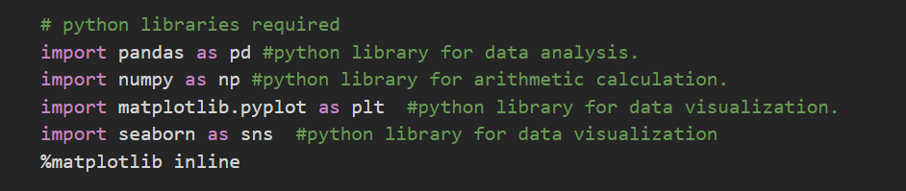
Data Understanding
The dataset was opened in Microsoft Excel, saved in a csv format and imported into Jupyter Notebook which is the IDE used for this project.
Started by importing all necessary modules for the analysis.
A dataframe called df was created and data loaded into it using the pd.read_csv() method since the data was saved in a csv format.
After loading, the data was validated by using the df.head() and df.tail() methods to get the first 5 and last 5 rows respectively.

Slide 5
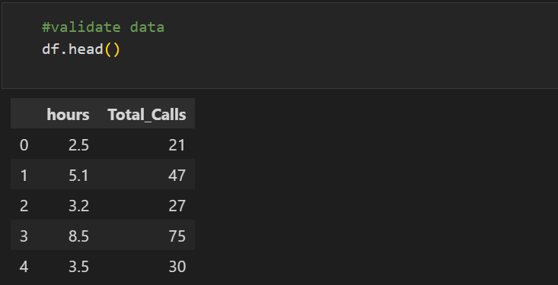

Slide 6
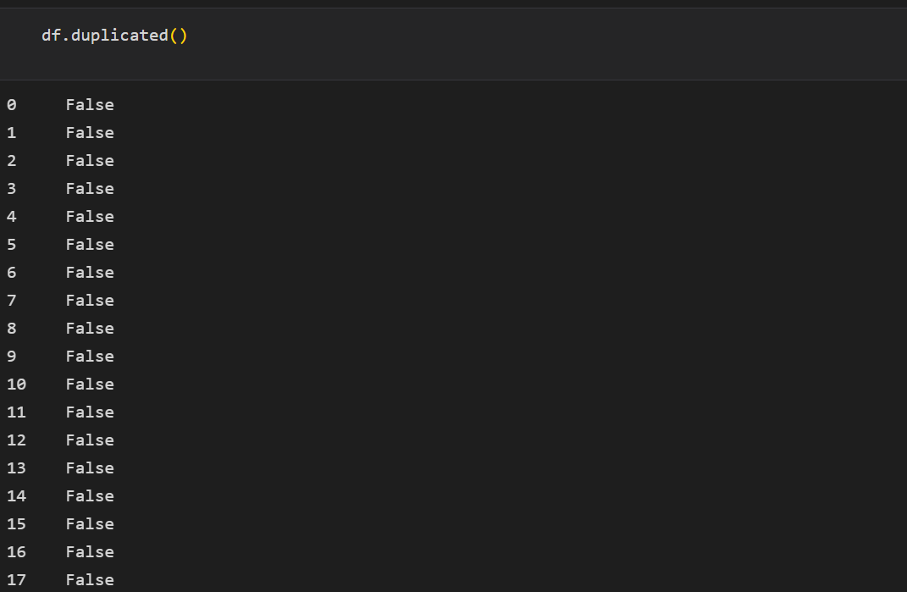
Data Cleaning
This process involved checking for datatypes, missing and duplicates valuesstandardizing column names, performing correlational and outlier analysis to check the relationship between variables and extreme values, respectively and feature engineering.
Checked for duplicated values by using the pandas method .duplicated() .
Output
From the output, there are no duplicated values in the dataset.

Slide 7
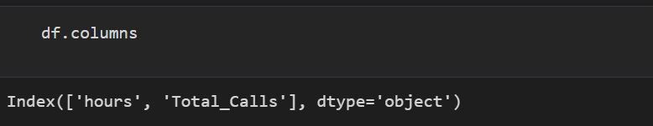
Also checked for missing values by using the pandas method .isnull() .
Output
From the output, there are no missing values in the dataset.
Checked column names with .columns and .lower() to convert to lower cases.

Slide 8
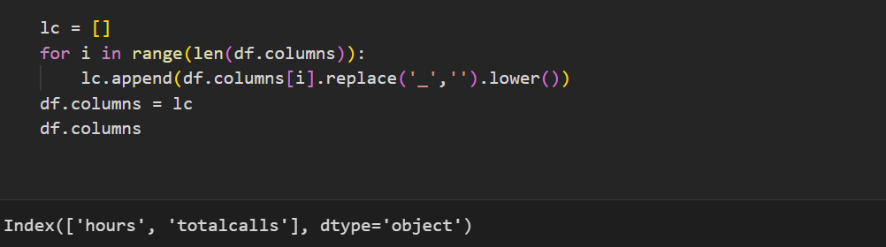
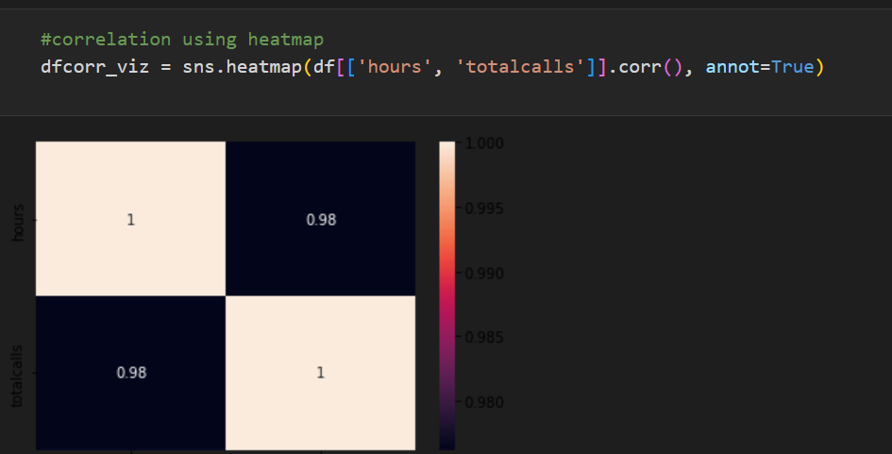
And transformed to lower cases with the following code:
Column names are now standardized.
Performed correlational analysis using the heatmap to show relationship between variables of the dataset.
There is a strong positive correlation between the number of hours and the total calls recorded.

Slide 9
Performed an outlier analysis to check for extreme tenure values using a boxplot visual.
There are no outliers in tenure column.

Slide 10
Featured Engineering
This process involves creating new metrics for columns needed for the analysis, removing variables not needed and changing categorical variables to numeric to prepare for model building.
In this case, no columns were dropped or added because we already have the necessary columns for the model.

Slide 11
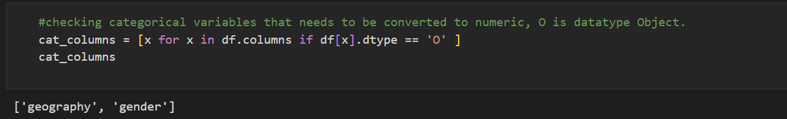
Checked for categorical columns that are in the dataset because they have to be converted to numeric.
No categorical variables were found, hence there is no need converting to numeric.

Slide 12
Insights
There are a total of 25 observations with 2 variables(columns).
There are no missing values, and all variables have their correct data types.
No duplicates were also recorded.
There are no outliers.
There is a strong positive correlation between the number of hours and the total calls recorded.

Slide 13
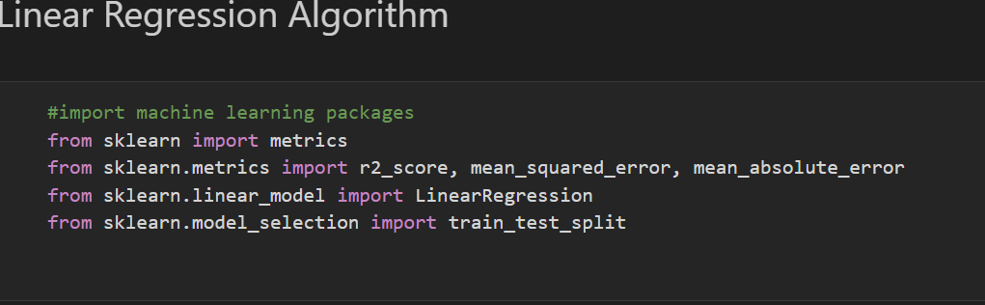
Modelling
This prediction model is a regression model since the result will be numeric and the model will be built with Linear Regression Algorithm.
We also must define the input(independent variables) and output(dependent variables) features. The dependent variable will be the column to be predicted while the independent will be all other columns after the forecasted column has been dropped.
The dependent variable will be dropped using the .drop() method in python.
The necessary python libraries needed for machine learning are also imported below:

Slide 14
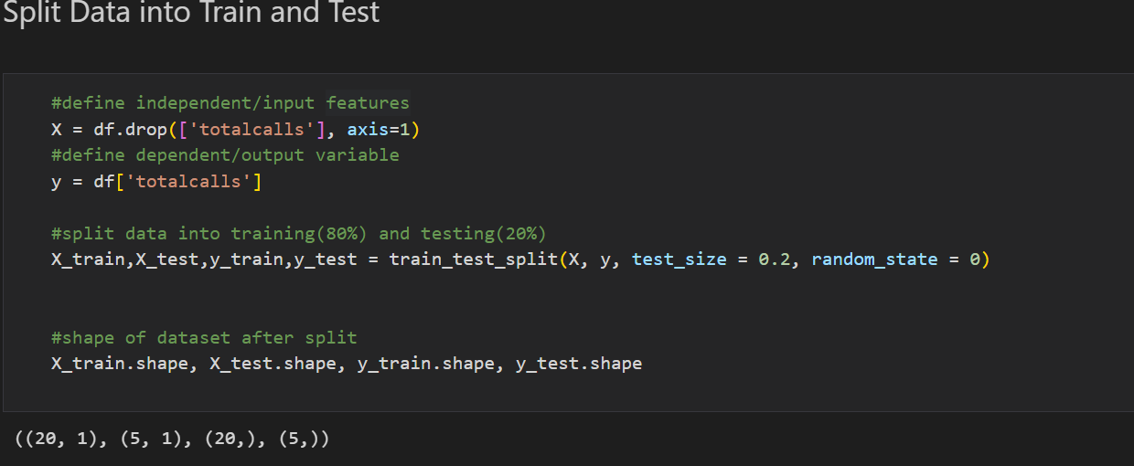
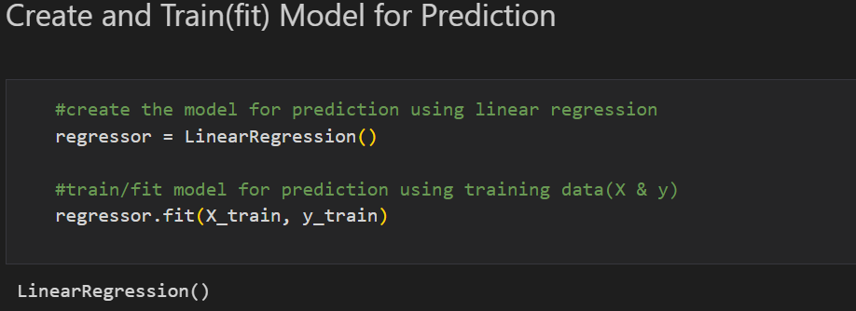
The data must be split into Training and Testing sets which is usually divided using the 80:20 ratio rule i.e., model will be trained with 80% od the data and tested with 20% of the data.
The Regression model to be used is created and trained using .fit() method below.

Slide 15
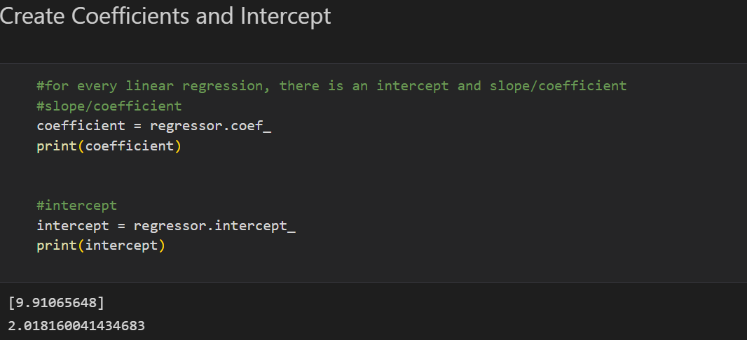
The coefficient/slope of this model is 9.91 which means that for every hour, there is approximately 10 calls recorded.

Slide 16
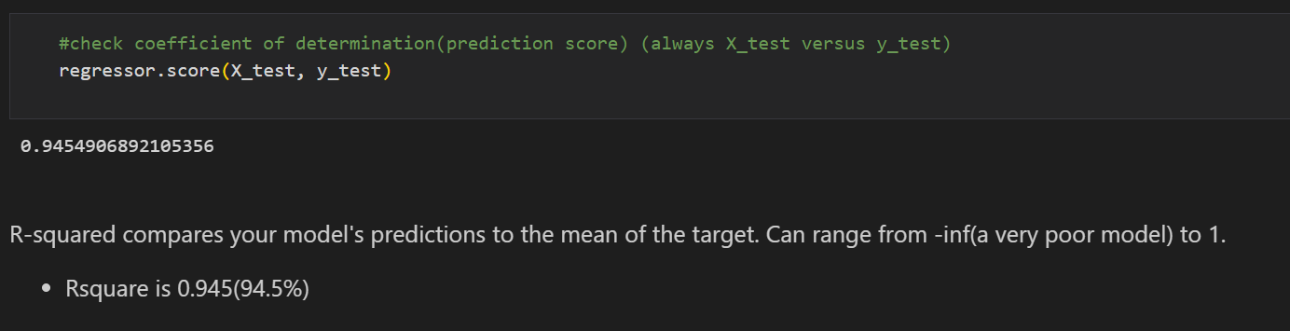
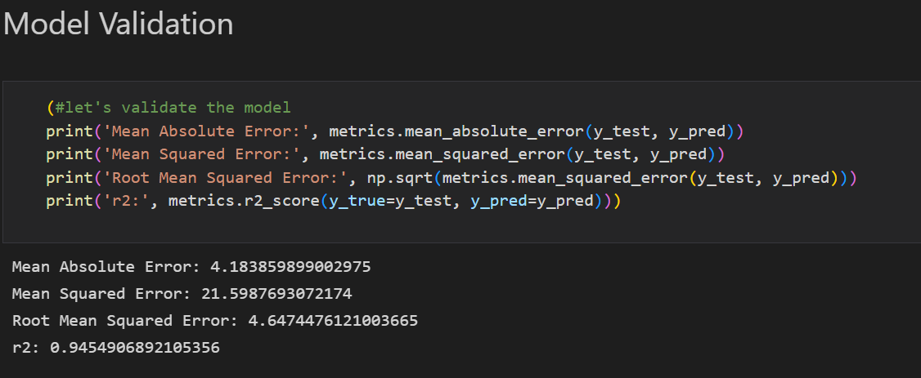
Model Evaluation
To evaluate the model, we used .score() to check for the coefficient of determination(R^2)

Slide 17
Insights
The model has:
Mean Absolute Error of 4.1836
Mean Squared Error of 21.5987
Root Mean Squared Error of 4.6474
R-squared of 0.9454

